Slide 1






AN UNDERGRADUATE PROJECT PRESENTED TO ELECTRONIC ENGINEERING DEPARTMENT
BY
Ukiwe StephanIE 2015/204628
Uzochukwu somto JosepH 2015/200146
Ugwu somtochukwu Arinze 2015/197948

Slide 2
PROJECT TOPIC
AUTOMATIC HAND SANITIZER/WATER DISPENSER WITH DATA LOGGING SYSTEM

Slide 3
PROJECT SUPERVISOR
ENGR. NATHAN DAVID

Slide 4
Introduction
The world changed so much in the year 2020. Handwashing became a mantra for people and for society due to the effects of the COVID-19 Pandemic. The Coronavirus changed so many things we normally did like hugging, shaking hands, talking freely and roaming around at free will. Now, we all keep safe distances from others and frequently wash our hands and use alcohol based hand sanitizers often.
As time passes and this new normal becomes a way of life for everyone, these habits and newly gained consciousness about Health and hygiene will stay for a long time, Global Pandemic or not.

Slide 5
Aim & Objectives
The aim of this project is to implement not just an automatic dispenser of soap and sanitizer, but one with the capabilities of collecting and storing user data. Through the implemented Data logging system, this projects records & saves user data pertaining to;
Time of use
Duration of use
Number of users
This project seeks to eliminate contact between the user and the handwashing mechanism thereby greatly reducing the risk of Viral transmission and encouraging effective Healthy Human Hygiene practices simultaneously.

Slide 6
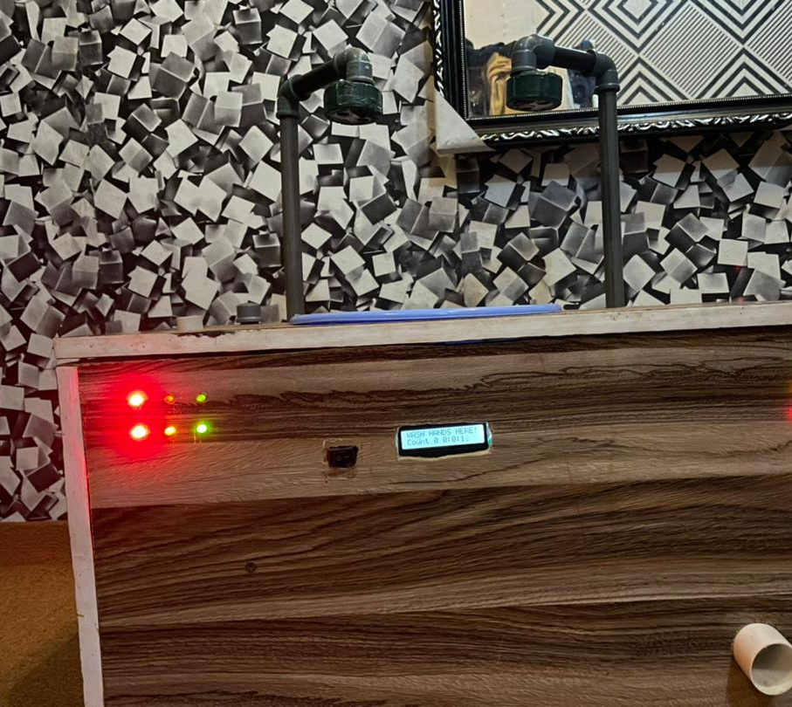
This system was made from locally sourced materials. It is capable of doing the following;
Dispensing Water/Soap
Dispensing Hand Sanitizer Fluid
Keeping accurate record of Data
Notifying changes in Battery level
Changes in fluid levels

Slide 7
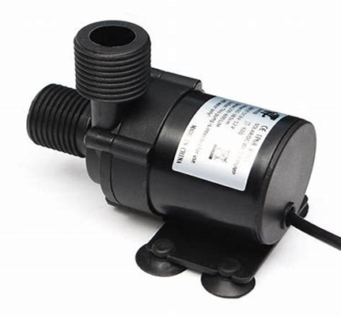
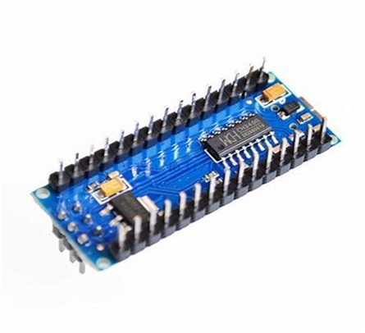
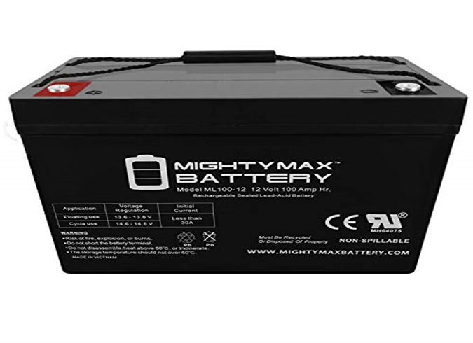
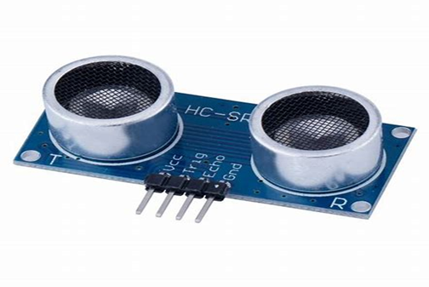
Materials Used in implementation
Wood for the external framework
Ultrasonic sensors
12V Lead acid battery
Arduino Nano Microcontroller
Mini Water pump and other electronic components.

Slide 8
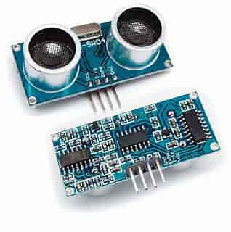
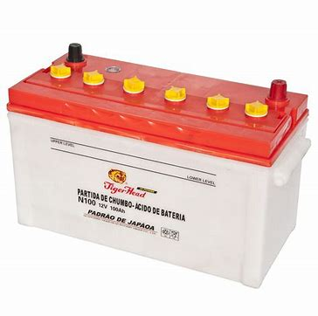
Criteria for choosing important Components
Ultrasonic sensor
Lead Acid battery
Cost effective
Solar enabled recharge
Can remain idle for a very long time without discharging
It is a proximity sensor
Not affected by changes in ambience
Unnafected by heat

Slide 9
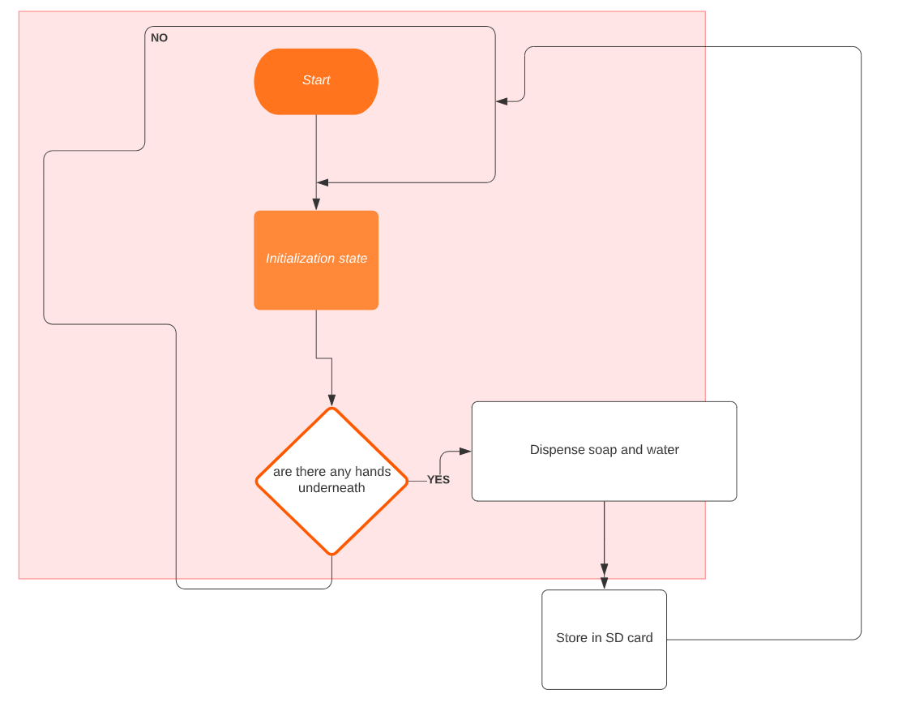
Flow chart
The system starts when the switch is ON
It enters the initialization state
Sensors check to detect hand proximity
Once hand is detected, pumps dispense liquid/sanitizer
After dispensing, the information is logged on the mounted SD card
The system goes back to initialization state and repeats the process

Slide 10
Steps taken during implementation
Compartments were made on the wooden frame for handles, LEDs, sink, LCD and PVC pipe
A plastic bowl was used as a sink to trap the dispensed water while handwashing is taking place
LED’s were connected to the 1k resistors and the transistors.
The Liquid Crystal Display and Ultrasonic sensors were interfaced with the Arduino
The water pumps were connected to the sensors using a Relay for the purpose of switching them ON/OFF
The entire system was connected to a 12V Battery that acts as a DC power source

Slide 11
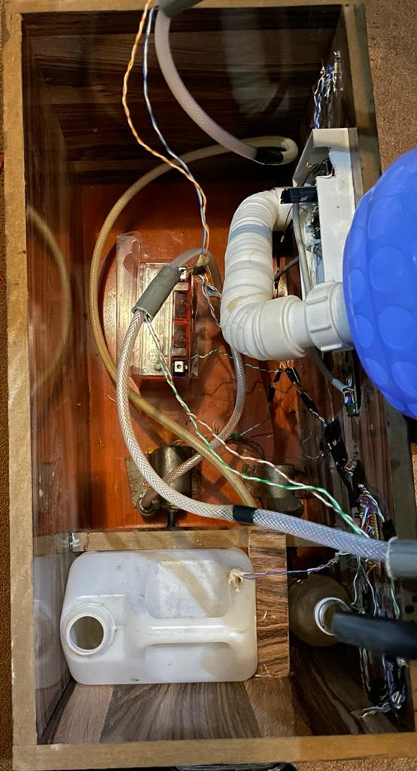
SYSTEM DESIGN AND IMPEMENTATION

Slide 12
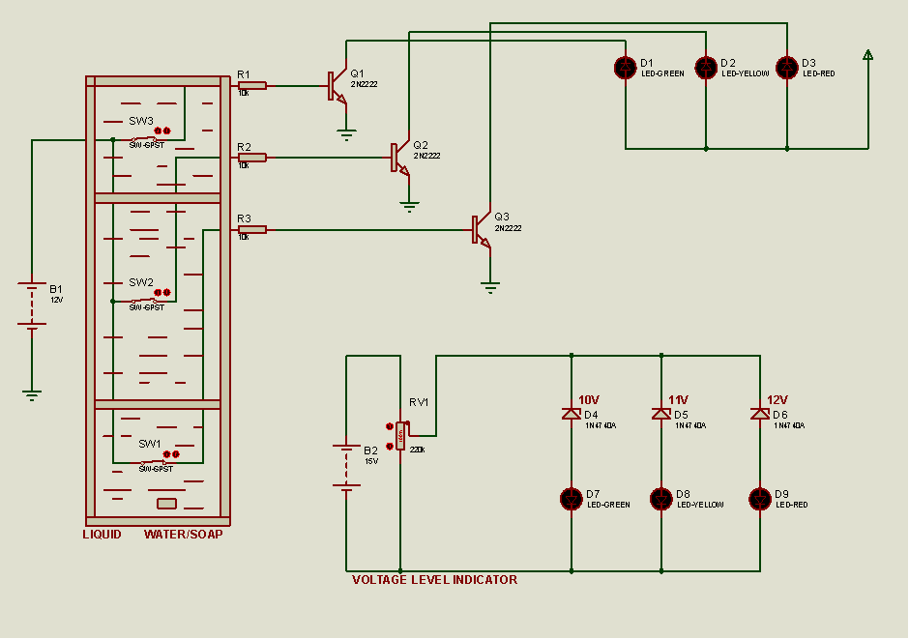
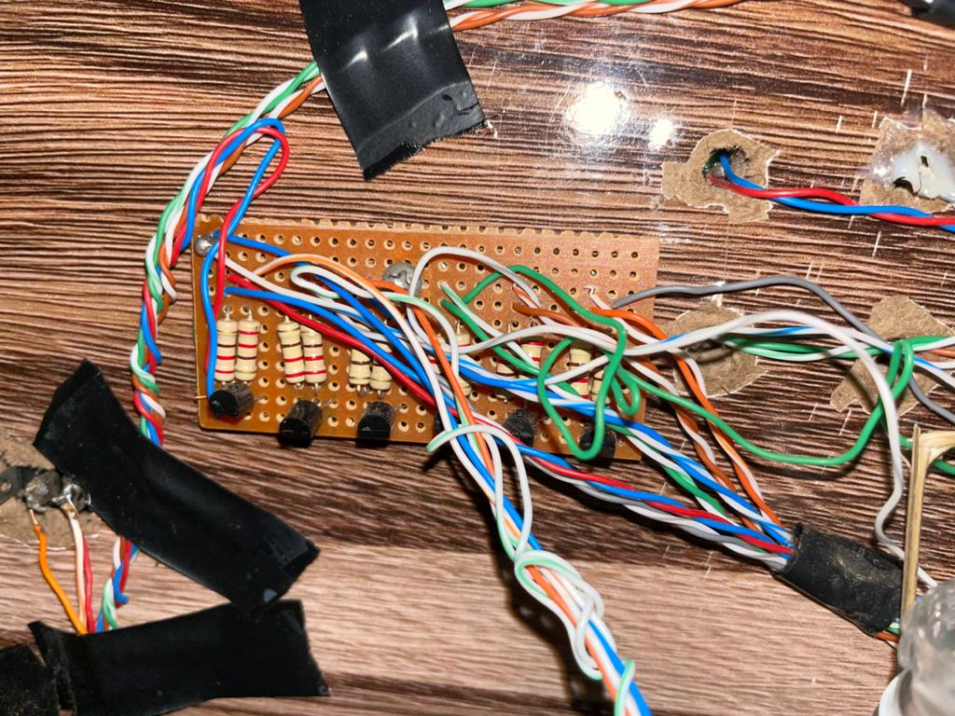
IMPLEMENTATION OF WATER LEVEL INDICATOR
CIRCUIT DIAGRAM FOR WATER LEVEL INDICATOR

Slide 13
CONCLUSION
The Automatic Dispenser for Soap/Water and Sanitizer implemented is functional and all aims and objectives were achieved.
The data logging system was also implemented successfully. It records and stores all useful information on an external SD Card, which can then be retrieved and accessed anytime it is required.
The system could be further upgraded and is considered indispensable in Hospitals, Institutions of Learning, Homes, Offices and other organizations where Hygiene is of great importance.

